Slide 1
Numbers and computers
Amit Amritkar

Slide 2
Agenda
Chapters 3 and 4 from book
“Scientific computing for engineers”
By Chapra and Canale
Bits/Bytes
Reality of Numbers
Integers
Significant digits, precision
Errors
Normalized representation
Floating‐point
Precision 32‐bit, 64‐bit, IEEE standard 754
Overflow, underflow, hole‐at‐zero, machine epsilon
Loss of precision
Complex numbers

Slide 3
Everything is bits
Each bit is 0 or 1
By encoding/interpreting sets of bits in various ways
Computers determine what to do (instructions)
… and represent and manipulate numbers, sets, strings, etc…
Why bits? Electronic Implementation
Easy to store with bistable elements
Reliably transmitted on noisy and inaccurate wires
0
1
0
1.1V
0.9V
0.2V
0.0V
Bryant and O’Hallaron, Lecture notes - Introduction to Computer Systems, Fall 2015

Slide 4
For example, can count in binary
Base 2 Number Representation
Represent 15213₁₀ as 11101101101101₂
Represent 1.20₁₀ as 1.0011001100110011[0011]…₂
Represent 1.5213 X 10⁴ as 1.1101101101101₂ X 2¹³
Bryant and O’Hallaron, Lecture notes - Introduction to Computer Systems, Fall 2015

Slide 5
Binary conversion Example
x = 15213: 00111011 01101101
y = -15213: 11000100 10010011
Bryant and O’Hallaron, Lecture notes - Introduction to Computer Systems, Fall 2015

Slide 6
Encoding Byte Values
Decimal
Hex
Binary
Byte = 8 bits
Binary 000000002 to 111111112
Decimal: 010 to 25510
Hexadecimal 0016 to FF16
Base 16 number representation
Use characters ‘0’ to ‘9’ and ‘A’ to ‘F’
Used to represent memory addresses
0
0
0000
1
1
0001
2
2
0010
3
3
0011
4
4
0100
5
5
0101
6
6
0110
7
7
0111
8
8
1000
9
9
1001
A
10
1010
B
11
1011
C
12
1100
D
13
1101
E
14
1110
F
15
1111
Bryant and O’Hallaron, Lecture notes - Introduction to Computer Systems, Fall 2015

Slide 7
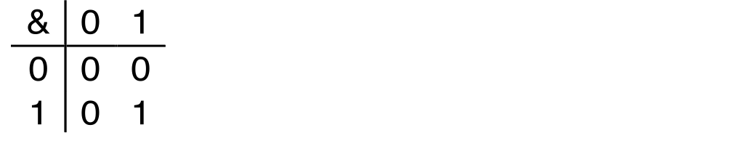
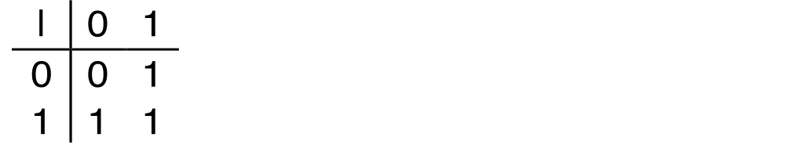
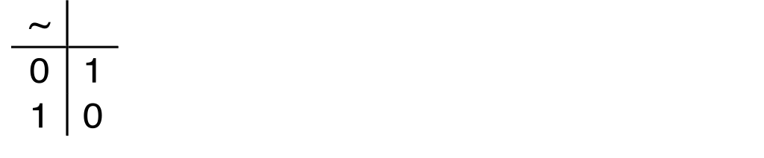
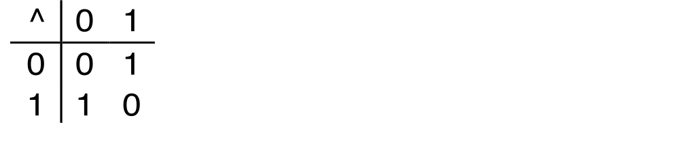
Boolean Algebra
Developed by George Boole in 19th Century
Algebraic representation of logic
Encode “True” as 1 and “False” as 0
And
A&B = 1 when both A=1 and B=1
Or
A|B = 1 when either A=1 or B=1
Not
~A = 1 when A=0
Exclusive-Or (Xor)
A^B = 1 when either A=1 or B=1, but not both
Bryant and O’Hallaron, Lecture notes - Introduction to Computer Systems, Fall 2015

Slide 8
General Boolean Algebras
Operate on Bit Vectors
Operations applied bitwise
All of the Properties of Boolean Algebra Apply
Operations
& Intersection (and)
| Union (or)
^ Symmetric difference (xor)
~ Complement (not)
01101001
& 01010101
01000001
01101001
| 01010101
01111101
01101001
^ 01010101
00111100
~ 01010101
10101010
01000001
01111101
00111100
10101010
Bryant and O’Hallaron, Lecture notes - Introduction to Computer Systems, Fall 2015

Slide 9
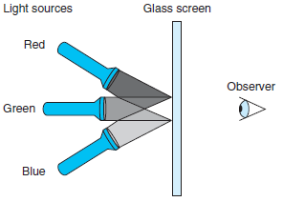
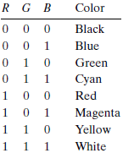
Boolean algebra example
Computers generate color pictures on a video screen or liquid crystal display by mixing three different colors of light: red, green, and blue
Computer Systems: A Programmer's Perspective, 3/E (CS:APP3e) Randal E. Bryant and David R. O'Hallaron

Slide 10
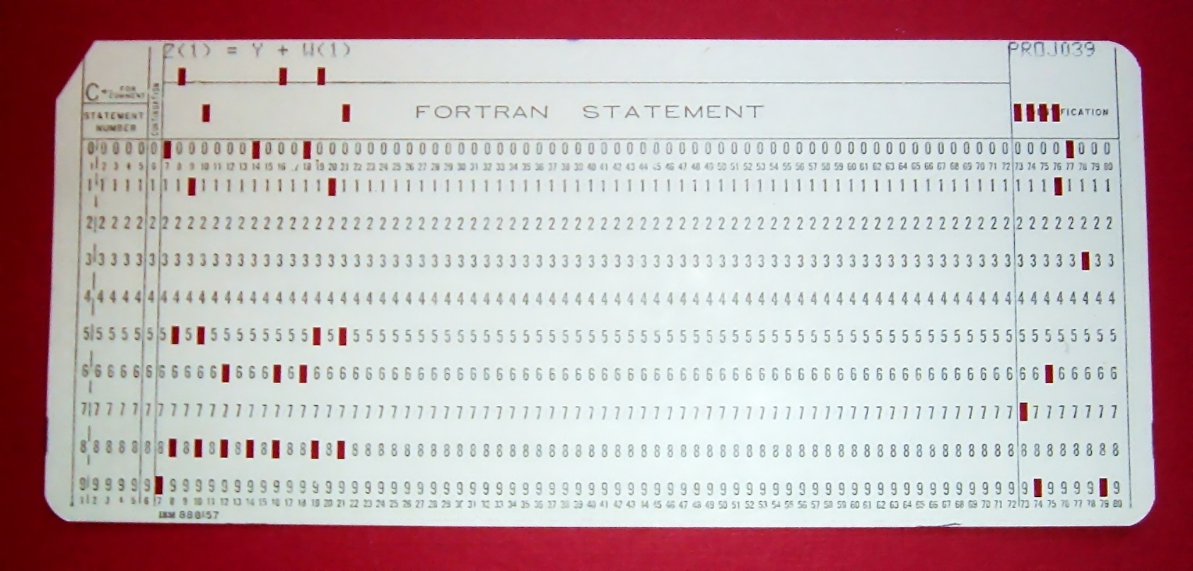
FORTRAN punch card for Z(1) = Y + W(1)
https://en.wikipedia.org/wiki/Punched_card

Slide 11
Byte-Oriented Memory Organization
00•••0
FF•••F
• • •
Programs refer to data by address
Conceptually, envision it as a very large array of bytes
In reality, it’s not, but can think of it that way
An address is like an index into that array
and, a pointer variable stores an address
Note: system provides private address spaces to each “process”
Think of a process as a program being executed
So, a program can clobber its own data, but not that of others
Bryant and O’Hallaron, Lecture notes - Introduction to Computer Systems, Fall 2015

Slide 12
Machine Words
Any given computer has a “Word Size”
Nominal size of integer-valued data
and of addresses
Until recently, most machines used 32 bits (4 bytes) as word size
Limits addresses to 4GB (2³² bytes)
Increasingly, machines have 64-bit word size
Potentially, could have 18 EB (exabytes) of addressable memory
That’s 18.4 X 10¹⁸
Machines still support multiple data formats
Fractions or multiples of word size
Always integral number of bytes
Bryant and O’Hallaron, Lecture notes - Introduction to Computer Systems, Fall 2015

Slide 13
Word-Oriented Memory Organization
32-bit
Words
64-bit
Words
Bytes
Addr.
Addresses Specify Byte Locations
Address of first byte in word
Addresses of successive words differ by 4 (32-bit) or 8 (64-bit)
0000
Addr
=
??
0001
0000
0002
Addr
=
??
0003
0000
0004
Addr
=
??
0005
0004
0006
0007
0008
Addr
=
??
0009
0008
0010
Addr
=
??
0011
0008
0012
Addr
=
??
0013
0012
0014
0015
Bryant and O’Hallaron, Lecture notes - Introduction to Computer Systems, Fall 2015

Slide 14
Example Data Representations
MATLAB | C Data Type | Typical 32-bit | Typical 64-bit | x86-64
char | Char | 1 | 1 | 1
 | Short | 2 | 2 | 2
int32 | int | 4 | 4 | 4
 | long | 4 | 8 | 8
Single | float | 4 | 4 | 4
double | double | 8 | 8 | 8
 | long double | − | − | 10/16
 | pointer | 4 | 8 | 8
All values are in Bytes (1 byte = 8 bits)
Bryant and O’Hallaron, Lecture notes - Introduction to Computer Systems, Fall 2015

Slide 15
Byte Ordering
So, how are the bytes within a multi-byte word ordered in memory?
Conventions
Big Endian: Sun, PPC Mac, Internet
Least significant byte has highest address
Little Endian: x86, ARM processors running Android, iOS, and Windows
Least significant byte has lowest address
Bryant and O’Hallaron, Lecture notes - Introduction to Computer Systems, Fall 2015

Slide 16
Byte Ordering Example
Example
Variable x has 4-byte value of 0x01234567
Address given by &x is 0x100
Big Endian
0x100
0x101
0x102
0x103
01
01
23
23
45
45
67
67
Little Endian
0x100
0x101
0x102
0x103
67
67
45
45
23
23
01
01
Bryant and O’Hallaron, Lecture notes - Introduction to Computer Systems, Fall 2015

Slide 17
Reality of Numbers
What is the largest named number you know?
What is the closest number to zero you can name?
Now what is that number plus the largest number?

Slide 18
Reality of Numbers
Integers: …, −2, −1, 0, 1, 2, …
Rational: ½, ⅔, ⅗, …
Irrational: π, e, √2, …
Real: 1.234, 0.000056, …
Complex: 1 + 2i
Quaternion: 1 + i + 2j – k
Vector
Tensor
Etc

Slide 19
Reality of Numbers
As humans we have a symbolic number system that given any amount of time we can give a precise definition, for example:
Define pi
Construct sqrt(2)

Slide 20
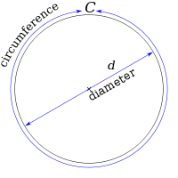
Reality of Numbers
As humans we have a symbolic number system that given any amount of time we can give a precise definition, for example:
Define pi
3.14 (Incorrect for most practical purposes)
22/7 (Better but still wrong)
C / d (Correct but not so useful)
Notes:
Image: Public Domain - http://en.wikipedia.org/wiki/File:Pi_eq_C_over_d.svg

Slide 21
Reality of Numbers
Computers have a limited amount of space for numbers. How does this change how we compute?
We use standards so numbers on one machine are similar to another

Slide 22
Reality of Numbers
Computers have a limited amount of space for numbers. How does this change how we compute?
Use standards
numbers on one machine should be similar to others
IEEE 754 Standard for Binary Floating-Point Arithmetic

Slide 23
Reality of Numbers
Computers have a limited amount of space for numbers. How does this change how we compute?
Use correct algorithms
Errors can accumulate via round off
Errors can also accumulate due to truncation or interpolation
See Nicholas Higham’s Accuracy and Stability of Numerical Algorithms aka BIBLE of numerical stability

Slide 24
Digital Machine Representation
COSC4364
Lennart Johnsson 2016-01-19
Every digital computer can only represent a finite number of digits
Irrational numbers cannot be represented (e.g. 1/3)
Only rational numbers that fit the machine representation can be represented exactly. The set depends on number system used and the number of machine digits in that representation
Numbers may be too large, or too small resulting in overflow or underflow
The finite number of digits limits the precision with the machine epsilon defining the smallest interval between numbers that can be represented
Johnsson L., Lecture notes spring 2016

Slide 25
Numbers in Science and Engineering
• Integers: signed and unsigned
• Floating point numbers: The IEEE-754 specification
• Floating point math
• Overflow and Underflow

Slide 26
Integers
Scientific computation mostly uses real numbers. Integers are mostly used for array indexing.
16/32/64 bit: short,int,long,long long in C, size not standardized, use sizeof(long) et cetera. (Also unsigned int et cetera)

Slide 27
Integers
In C, commonly:
char (one byte)
short (two bytes)
int (four bytes)
long (eight bytes)
NOTE: This is not standardized and may vary between compilers and installations. A careful programmer will use sizeof() when in doubt.
We will focus on the canonical 32-bit int type

Slide 28
Integers: Representation
2⁷ | 2⁶ | 2⁵ | 2⁴ | 2³ | 2² | 2¹ | 2⁰
0 | 0 | 1 | 0 | 1 | 0 | 1 | 0
2¹ | 2
2³ | 8
2⁵ | 32
Sum: | 42
42

Slide 29
Machine Integer Arithmetic
2³¹ | 2³⁰ | 2²⁹ | 2²⁸
1 | 1 | 1 | 1
2³ | 2² | 2¹ | 2⁰
1 | 1 | 1 | 1
4294967295
2³¹ | 2³⁰ | 2²⁹ | 2²⁸
0 | 0 | 0 | 0
2³ | 2² | 2¹ | 2⁰
0 | 0 | 0 | 1
+ 1
2³¹ | 2³⁰ | 2²⁹ | 2²⁸
0 | 0 | 0 | 0
2³ | 2² | 2¹ | 2⁰
0 | 0 | 0 | 0
= 0

Slide 30
Signed Integers: Two's Complement
2³¹ | 2³⁰ | 2²⁹ | 2²⁸
0 | 0 | 0 | 0
2³ | 2² | 2¹ | 2⁰
0 | 0 | 0 | 0
0
2³¹ | 2³⁰ | 2²⁹ | 2²⁸
0 | 0 | 0 | 0
2³ | 2² | 2¹ | 2⁰
0 | 0 | 0 | 1
- 1
2³¹ | 2³⁰ | 2²⁹ | 2²⁸
1 | 1 | 1 | 1
2³ | 2² | 2¹ | 2⁰
1 | 1 | 1 | 1
= -1

Slide 31
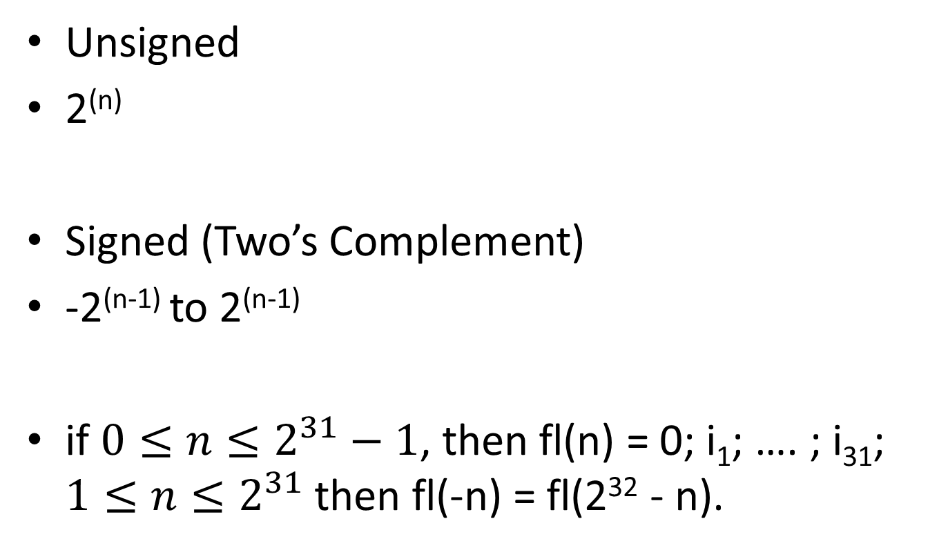
Encoding Integers
Unsigned
2^{(n)}
Signed (Two’s Complement)
-2^{(n-1)} to 2^{(n-1)}
if $0≤n≤2^{31}−1$, then fl(n) = 0; i₁; …. ; i₃₁; $1≤n≤2^{31}$then fl(-n) = fl(2³² - n).
n is the number of bits
Bryant and O’Hallaron, Lecture notes - Introduction to Computer Systems, Fall 2015

Slide 32
Integers
Questions to consider
How do you create numbers larger than 2^32?
How do you detect that your numbers have overflowed?
If I'm using big numbers should I just switch to floating point?

Slide 33
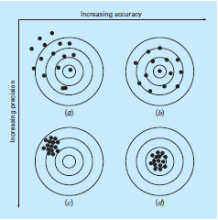
Accuracy and Precision
Accuracy refers to how closely a computed or measured value agrees with the true value.
Precision refers to how closely individual computed or measured values agree with each other.

Slide 34
COSC4364
Accuracy
Lennart Johnsson 2016-01-19
Accurate to n decimal places means that you can trust n digits to the right of the decimal place.
Accurate to n significant digits means that you can trust a total of n digits as being meaningful beginning with the leftmost nonzero digit.
Johnsson L., Lecture notes spring 2016

Slide 35
COSC4364
Lennart Johnsson 2016-01-19
Significant Digits
Traditional Place‐value notation:
Leftmost non‐zero digit most significant
Example: 123 = one hundred twenty three in the traditional place‐value decimal notation. (formally d₂d₁d₀ with value d₂10²+d₁10¹+d₃10⁰)
Significant digits of precision are the correct digits starting with the most significant digit and ending with the rightmost correct digit
Johnsson L., Lecture notes spring 2016

Slide 36
COSC4364
Significance of Precision
Example:
0.1036x+0.2122y=0.7381
0.2081x+0.4247y=0.9327
Lennart Johnsson 2016-01-19
Solving with Gaussian elimination using 3 digits of precision using rounding
0.104x+0.212y=0.738
0.208x+0.425y=0.933
Multiply 1st eq. by 2 and subtract from 2nd eq.
0.001y = 0.933‐1.48 = ‐0.547
y = ‐547
Johnsson L., Lecture notes spring 2016

Slide 37
COSC4364
Significance of Precision
Example cont’d
0.1036x+0.2122y=0.7381
0.2081x+0.4247y=0.9327
Solving with Gaussian elimination using 4 digits of precision using rounding
Lennart Johnsson 2016-01-19
Multiply 1st eq. by (0.2081/0.1036) ≈ 2.009
and subtract from 2nd eq.
(0.2081 – 0.1036*2.009)x+(0.4247‐2.009*0.2122)y = 0.9327‐2.009*0.7381
0.2081 0.4263
1.483
‐0.0016 y = ‐ 0.5503
y = 343.9
Johnsson L., Lecture notes spring 2016

Slide 38
COSC4364
Significance of Precision
Example cont’d
0.1036x+0.2122y=0.7381
0.2081x+0.4247y=0.9327
Lennart Johnsson 2016-01-19
Solving with Gaussian elimination using 10 digits of precision using rounding
Multiply 1st
eq. by (0.2081/0.1036) ≈ 2.008687259 = m
and subtract from 2nd eq.
(0.2081 – 0.1036*m)x+(0.4247‐m*0.2122)y = 0.9327‐m*0.7381
` 0.2081 0.4262434363 1.482612066
‐0.0015434363 y = ‐ 0.5499120656
y = 356.2907427
Johnsson L., Lecture notes spring 2016

Slide 39
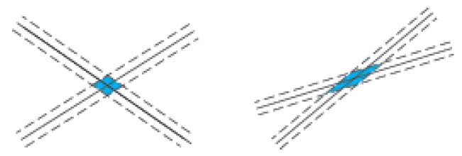
COSC4364
Significance of Precision
Problems for which the variation in the
Lennart Johnsson 2016-01-19
solution due to small changes in the input data also are small are said to be well‐posed.
Problems for which the variation in the solution due to small changes in the input data may be large are said to be ill‐posed.
Johnsson L., Lecture notes spring 2016

Slide 40
COSC4364
Errors
Lennart Johnsson 2016-01-19
Absolute
|True value – Approximate value|
Relative
(|True value – Approximate value|)/|True value|
True value is not always known. If not then the best known value is used as a substitute.
Johnsson L., Lecture notes spring 2016

Slide 41
COSC4364
Lennart Johnsson 2016-01-19
Absolute and Relative Errors
Example 1. | True value | = 1.333,
 | Approx. value | = 1.334
– Absolute error: 0.001
– Relative error:
0.00075
Example 2: True value
Approx. value
– Absolute error: 0.001
– Relative error: 1
= 0.001,
= 0.002
In most cases the relative error is the more relevant error information of the two measures
Johnsson L., Lecture notes spring 2016

Slide 42
COSC4364
Lennart Johnsson 2016-01-19
Absolute and Relative Errors
• Example 3. x = 0.00347. Rounded x_{r} = 0.0035
– Absolute error: 0.00003
– Relative error:
0.00003/0.00347 = 0.00865
Example 4: x = 30.158. Rounded x_{r} = 30.16
– Absolute error: 0.002
– Relative error:0.002/30.158=0.000066
Example 3 has 2 significant digits, Example 4 has 4
In most cases the relative error is the more relevant error information of the two measures
Johnsson L., Lecture notes spring 2016

Slide 43

Real numbers – integers
Most commonly encountered in scientific computing
Represented using floating point numbers on computers

Slide 44
Normalized Numbers
Common decimal number representation:
Examples: 37.21829, 0.002271828 and 3000527.11059
Numbers represented as an Integer, Decimal Point, and Fraction
Require first digit in the mantissa to be nonzero.
In binary this makes the first digit 1, so we don’t need to store it.
Unique representation for each number.
Example: Allow 3.01 x 10⁰ but not 0.0301 x 10²
An alternative style is to have the first non-zero digit after the decimal point.

Slide 45
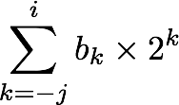
Fractional Binary Numbers
Carnegie Mellon
2^{i}
2^{i-1}
4
2
1
• • •
bi | bi-1 | ••• | b2 | b1 | b0 | b-1 | b-2 | b-3 | ••• | b-j
1/2
1/4
1/8
2^{-j}
• • •
Representation
Bits to right of “binary point” represent fractional powers of 2
Represents rational number:
Bryant and O’Hallaron, Lecture notes - Introduction to Computer Systems, Fall 2015
Notes:
Latex source for equation: \sum_{k=-j}^i b_k \times 2^k

Slide 46
Fractional Binary Numbers: Examples
Carnegie Mellon
Value Representation
5 3/4 101.112
2 7/8 010.1112
1 7/16 001.01112
Observations
Divide by 2 by shifting right (unsigned)
Multiply by 2 by shifting left
Numbers of form 0.111111…2 are just below 1.0
1/2 + 1/4 + 1/8 + … + 1/2^{i} + … ➙ 1.0
Use notation 1.0 – ε
Bryant and O’Hallaron, Lecture notes - Introduction to Computer Systems, Fall 2015

Slide 47
Floating‐point numbers are spaced non‐uniformly
COSC4364
Lennart Johnsson 2016-01-19
Example x = ±0.b₁b₂b₃ x2 ^{± m}, b_{i},m = 0 or 1
24 non‐negative (and 24 non‐positive) numbers
0.000 x 2^{‐1} = 0 | 0.000 x 2⁰ = 0 | 0.000 x 2¹ = 0
0.001 x 2^{‐1} = 1/16 | 0.001 x 2⁰ = 1/8 | 0.001 x 2¹ = 1/4
0.010 x 2^{‐1} = 2/16 | 0.010 x 2⁰ = 2/8 | 0.010 x 2¹ = 2/4
0.011 x 2^{‐1} = 3/16 | 0.011 x 2⁰ = 3/8 | 0.011 x 2¹ = 3/4
0.100 x 2^{‐1} = 4/16 | 0.100 x 2⁰ = 4/8 | 0.100 x 2¹ = 4/4
0.101 x 2^{‐1} = 5/16 | 0.101 x 2⁰ = 5/8 | 0.101 x 2¹ = 5/4
0.110 x 2^{‐1} = 6/16 | 0.110 x 2⁰ = 6/8 | 0.110 x 2¹ = 6/4
0.111 x 2^{‐1} = 7/16 | 0.111 x 2⁰ = 7/8 | 0.111 x 2¹ = 7/4
Normalization forces us to drop 1/16, 1/8 and 3/16
The gap between 0 and the smallest positive number (and correspondingly for negative numbers) is known as the hole at zero.
https://en.wikiversity.org/wiki/Floating_point/Lesson_Three

Slide 48
IEEE Floating Point
Carnegie Mellon
IEEE Standard 754
Established in 1985 as uniform standard for floating point arithmetic
Before that, many idiosyncratic formats
Supported by all major CPUs
Driven by numerical concerns
Nice standards for rounding, overflow, underflow
Hard to make fast in hardware
Numerical analysts predominated over hardware designers in defining standard
Bryant and O’Hallaron, Lecture notes - Introduction to Computer Systems, Fall 2015

Slide 49
Precision options
Carnegie Mellon
Single precision: 32 bits
Double precision: 64 bits
Extended precision: 80 bits (Intel only)
s | exp | frac
1 | 8-bits | 23-bits
s | exp | frac
1 | 11-bits | 52-bits
s | exp | frac
1 | 15-bits | 63 or 64-bits
Bryant and O’Hallaron, Lecture notes - Introduction to Computer Systems, Fall 2015

Slide 50
COSC4364
Lennart Johnsson 2016-01-19
IEEE Floating‐Point Standard 754
Exponent
Sign is included in exponent field
Represented as
exponent value = exponent field : (2^{bits in exp field ‐1} ‐1)
(called excess or biased representation)
examples of bias(excess): single precision
double precision
Mantissa
2⁷ – 1 = 127
2¹⁰ ‐ 1 = 1023
– Represented as 1.f. The 1 to the left of the fraction is not explicitly represented. Thus, the mantissa actually has 1 more bit than the number of bits allocated to it.
Reserved exponent values
0 for the value 0 and denormalized numbers
31 in binary16, 255 in binary32, 2047 in binary 64 and 32768 in binary 128 (exponent field = 1111….11) for ∞ and NaN (Not a Number)
Johnsson L., Lecture notes spring 2016

Slide 51
IEEE Floating‐Point Standard 754
Single precision
COSC4364
Lennart Johnsson 2016-01-19
s | exp | frac
1 | 8-bits | 23-bits
Representable exponent range: ‐126 to 127
Representable mantissa: 1.0 to 1.111….1 = 1 to 2‐2^{‐23}
– Largest possible number: (2‐2²³)2¹²⁷ ≈ 2¹²⁸ ≈ 3.4 x 10³⁸
Smallest positive number: 2^{‐126} ≈ 1.2 x 10^{‐38}
Machine epsilon = 2^{‐24} ≈ 5.96 x 10^{‐8}, thus IEEE 754 single precision offers about 7 significant decimal digits of accuracy
Johnsson L., Lecture notes spring 2016

Slide 52
IEEE Floating‐Point Standard 754
Double precision
COSC4364
Lennart Johnsson 2016-01-19
s | exp | frac
1 | 11-bits | 52-bits
Representable exponent range: ‐1022 to 1023
Representable mantissa: 1.0 to 1.111….1 = 1 to 2‐2^{‐52}
Largest possible number: (2‐2⁵²)2¹⁰²³ ≈ 2¹⁰²⁴
≈ 1.8 x 10³⁰⁸
Smallest positive number: 2^{‐1022} ≈ 2.2 x 10^{‐308}
Machine epsilon = 2^{‐53} ≈ 1.11 x 10^{‐16}, thus IEEE 754 double precision offers about 15 significant decimal digits of accuracy
Johnsson L., Lecture notes spring 2016

Slide 53
Lennart Johnsson 2016-01-19
IEEE Floating‐Point Standard 754
Name
Common name
Mantissa
Exponent Decimal Decimal min max digits Exponent max
binary16 | Half precision | 11 | −14 | +15 | 3.31 | 4.51
binary32 | Single precision | 24 | −126 | +127 | 7.22 | 38.23
binary64 | Double precision | 53 | −1022 | +1023 | 15.95 | 307.95
binary128 | Quadruple precision | 113 | −16382 | +16383 | 34.02 | 4931.77
1 5 10
s exp mantissa
binary16
1 8 23
^{s} exp mantissa
binary32
1 11
^{s} exp
1 15
binary128 ^{s} exp
52
mantissa
binary64
112
mantissa
Johnsson L., Lecture notes spring 2016

Slide 54
Floating Point Operations: Basic Idea
Carnegie Mellon
x +f y = Round(x + y)
x ×f y = Round(x × y)
Basic idea
First compute exact result
Make it fit into desired precision
Possibly overflow if exponent too large
Possibly round to fit into frac
Bryant and O’Hallaron, Lecture notes - Introduction to Computer Systems, Fall 2015

Slide 55
Floating Point Addition
Align exponents
Add mantissas
Adjust exponent to normalize
Example: 1.00 + 2.00 × 10⁻² = 1.00 + .02 = 1.02.
This is exact, but what happens with 1.00 + 2.55 × 10⁻²?
Example: 5.00 × 10¹ + 5.04 = (5.00 + 0.504) × 10¹ → 5.50 × 10¹
Any error comes from truncating the mantissa:
if x is the true sum and y the computed sum,
then y = x (1 + ϵ) with |ϵ| < 10⁻²

Slide 56
Assignment 1 - Floating Point Addition
Sum the series 1/(n^2) from 1 to 10000.
Sum the series 1/(n^2) from 10000 to 1.
Why the difference? Compare single and double precision.

Slide 57
Guard Digits
Correctly rounding is not trivial, especially for subtraction. Example: 1.0 − 9.5 × 10⁻¹
Exact result 0.05 = 5.0 × 10⁻²
Simple approach:
1.0 − 9.5 × 10⁻¹ = 1.0 − 0.9 = 0.1 = 1.0 × 10⁻¹
Using 'guard digit':
1.0 − 9.5 × 10⁻¹ = 1.0 − 0.95 = 0.05 = 5.0 × 10⁻², exact.

Slide 58
Floating Point Multiplication
Add exponents
Multiply mantissas
Adjust exponent
Example:
.123 × .567 × 10¹ = .069741 × 10¹ → .69741 × 10⁰ → .697 × 10⁰.
What happens with relative errors?

Slide 59
Floating Point Subtraction
Example:
1.0000006 - 1.0000004 = 0.0000002 exact result
Machine (single precision):
1.0000006 -> 1.000001 - 1.0000004 -> 1.000000 =
0.000001 machine result

Slide 60
Consequences of Roundoff
Multiplication and addition are not associative: Different answer for reduction depending on order in which elements are combined
Source of error in parallel computations
Operations with "same" outcomes are not equally stable:
Matrix inversion is unstable, elimination is stable
Introduction of a Lyapunov instability:
Dynamical systems diverge from true trajectory

Slide 61
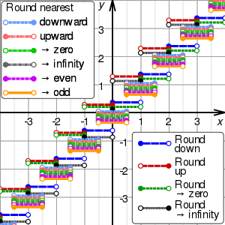
Rounding modes

Slide 62
Closer Look at Rounding in C
Carnegie Mellon
function round() for rounding to integers
0.1 to 0.4 is rounded down and 0.5 to 0.9 is rounded up
Is statistically biased
Sum of set of positive numbers will consistently be over- or under- estimated
When exactly halfway between two possible values
Round up
E.g., round to integer
789.49999 789 (Less than half way)
789.50001 790 (Greater than half way)
789.50000 790 (Half way—round up)
Assignment 2A - What happens if the number to be rounded is 789.49999999999999999999
Bryant and O’Hallaron, Lecture notes - Introduction to Computer Systems, Fall 2015

Slide 63
Assignment 2B
You are to write a rounding function for a financial app that rounds off real numbers to have only 2 decimal places (dollars and cents). Calculate the roundoff error.
NO CHEATING: Don’t look up codes on internet
Hint: in C/C++ use function floorf, roundf and ceilf for different roundoff strategies
Generalize your function (instead of 2 use ‘n’) and use it to solve the following system of simultaneous equations using different number of significant digits such that x and y should be accurate to 2 decimal places.
0.1036x+0.2122y=0.7381
0.2081x+0.4247y=0.9327

Slide 64
Lennart Johnsson 2016-01-19
Precision – Implementation considerations
Today’s server CPUs (Central Processing Unit)s generally supports the IEEE 754 standard.
Server CPUs generally support 64‐bit arithmetic in hardware, but 32‐bit arithmetic typically operate at double the rate of 64‐bit arithmetic. (64‐bit data requires twice the memory and twice the memory bandwidth of 32‐bit data. Memory bandwidth is a limiting factor in many applications.)
CPUs designed for the mobile and embedded market typically have not supported 64‐bit arithmetic in hardware. 64‐bit hardware increases die size (fewer dies per wafer) and reduce yield (lower fraction working dies) and hence increase cost. 64‐bit hardware increases energy consumption (operating cost, environmental impact) and reduces operating time in battery powered devices.
Energy consumption has become a major design constraint also for server CPUs and careful attention to precision has become an active research area, including the use of variable precision during computations. (The energy cost over the life‐ time of a system typically exceeds that of the system itself)
Johnsson L., Lecture notes spring 2016

Slide 65
Overflow and Underflow
Overflow: Let x be the largest representable number.
Attempting to multiply x by 10 will generate an overflow.
Example: multiply 9.123456 x 10³⁷ by 10.
Result: inf
Why? Unique representation for each normalized number:
Example: Divide 3.012345 x 10⁻³⁸ by 10.
Result: Number cannot be normalized because largest allowed exponent is 38. The new number can still be represented as 0.301234 x 10⁻³⁸, but it cannot be normalized. This is referred to as a subnormal number.

Slide 66
Special Values
NaN = "Not a number" (returned when attempting to take square root or logarithm of a negative number)
Inf = positive infinity
-Inf = negative infinity
zero
-zero

Slide 67
COSC4364
Loss of Significance
y = x‐sin(x), x=1/15
Lennart Johnsson 2016-01-19
Example
with 10 significant decimal digits x = 6.6666666667 x 10⁰
sin(x) = 6.6617294923 x 10⁰
y = 0.0004937175 x 10^{‐1}
y = 4.9371750000 x 10^{‐5} normalized
Spurious 0’s
y = 4.9371743275 x 10^{‐5}
correct to 10 significant digits
Johnsson L., Lecture notes spring 2016

Slide 68
COSC4364
Lennart Johnsson 2016-01-19
Loss of significance in subtraction
Example:
x= 1.111111x2⁰ y=1.111000x2⁰ x‐y = 0.000111x2⁰
x‐y = 1.110000x2^{‐4} (x‐y)/x = < 2^{‐4}
Johnsson L., Lecture notes spring 2016

Slide 69
COSC4364
Lennart Johnsson 2016-01-19
Avoiding Loss of Significance in Subtraction
Example:
y = sqrt(x²+1)–1 for x near 0
rewrite as
y = (sqrt(x²+1)–1)(sqrt(x²+1) +1)/(sqrt(x²+1)+1)
y = x²/(sqrt(x²+1)+1)
In 5 decimal digit arithmetic and x = 10^{‐3} without the rewrite y = 0, while the rewrite yields y = 0.5x10^{‐6}
Other examples of such tricks - https://en.wikipedia.org/wiki/Floating-point_arithmetic
Johnsson L., Lecture notes spring 2016

Slide 70
Floating Point in C
Carnegie Mellon
C Guarantees Two Levels
float single precision
double double precision
Conversions/Casting
Casting between int, float, and double changes bit representation
double/float → int
Truncates fractional part
Like rounding toward zero
Not defined when out of range or NaN
int → double
Exact conversion, as long as int has ≤ 53 bit word size
int → float
Will round according to rounding mode
Bryant and O’Hallaron, Lecture notes - Introduction to Computer Systems, Fall 2015

Slide 71
Complex Numbers
Two real numbers: real and imaginary part
Storage:
Store real/imaginary adjacent: easy to pass address of one number
Store array of real, then array of imaginary. Better for stride 1 access if only real parts are needed. Other considerations.

Slide 72
Summary
Machine numbers are NOT the same as physical numbers. They are merely an approximate representation of physical numbers. Know the pitfalls!
Floating point numbers are (almost) never equal!

Slide 73
Reference
Science and Technical Computing course materials by The Texas Advanced Computing Center, 2014. Available under a Creative Commons Attribution Non-Commercial 3.0 Unported License
Bryant and O’Hallaron, Lecture notes - Introduction to Computer Systems, Fall 2015
Johnsson L., Lecture notes spring 2016

Slide 74
Assignment 3
big ints – You’ve been given an array of 10,000 numbers between 0 and 1,000,000 and need to build out some way to compute the sum. Define a struct (class, array, whatever you will) that holds two integers a, b representing the number
a * BIG_INT + b
Create functions to sum larger integers via your struct. Write a tester that computes the 50th Fibonacci number with this struct. For extra credit, also provide 15! (i.e. factorial 15).

Slide 75

Assignment 3 continued
small numbers – Implement compensated sum routine.
Change the logic to compute , that is:
function sum series(arr)
error = 0
sum = 0
for a ∈ arr do
tmp = sum
y = a + error
sum = tmp + y
error = (tmp − sum) + y
end for
return sum
end function

Slide 76
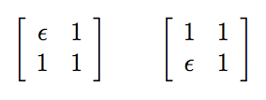
Assignment 4
In this section you will need to analyze the Gaussian Elimination algorithm. Use the provided file gaussian elimination test.c to take the inverse of the following matrices, verify A * A_{inv} = I.
where ε = 1e − 8.

